Slide 1
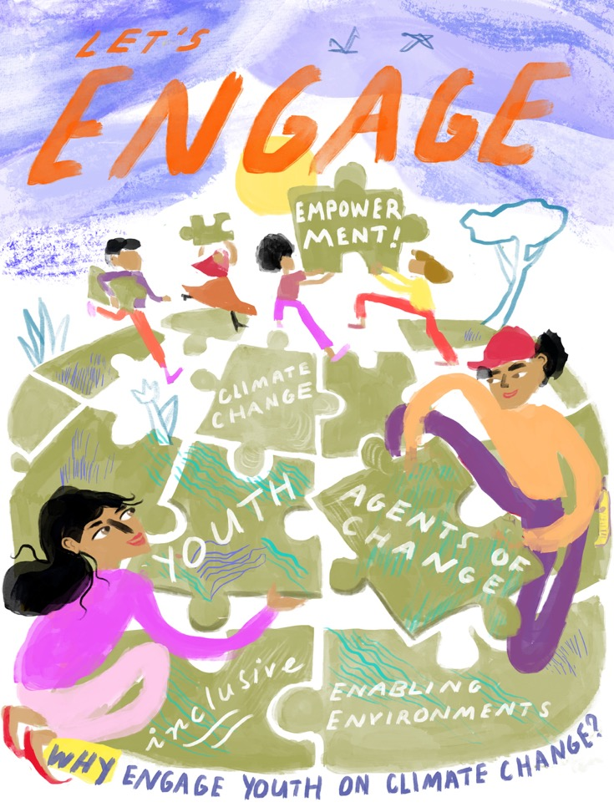
Youth Unit: Let’s ENGAGE!
Why engage youth on
climate change?
Notes:
[Note: click 'View' → 'Slide Master' to insert the title of the module in the footnote]

Slide 2
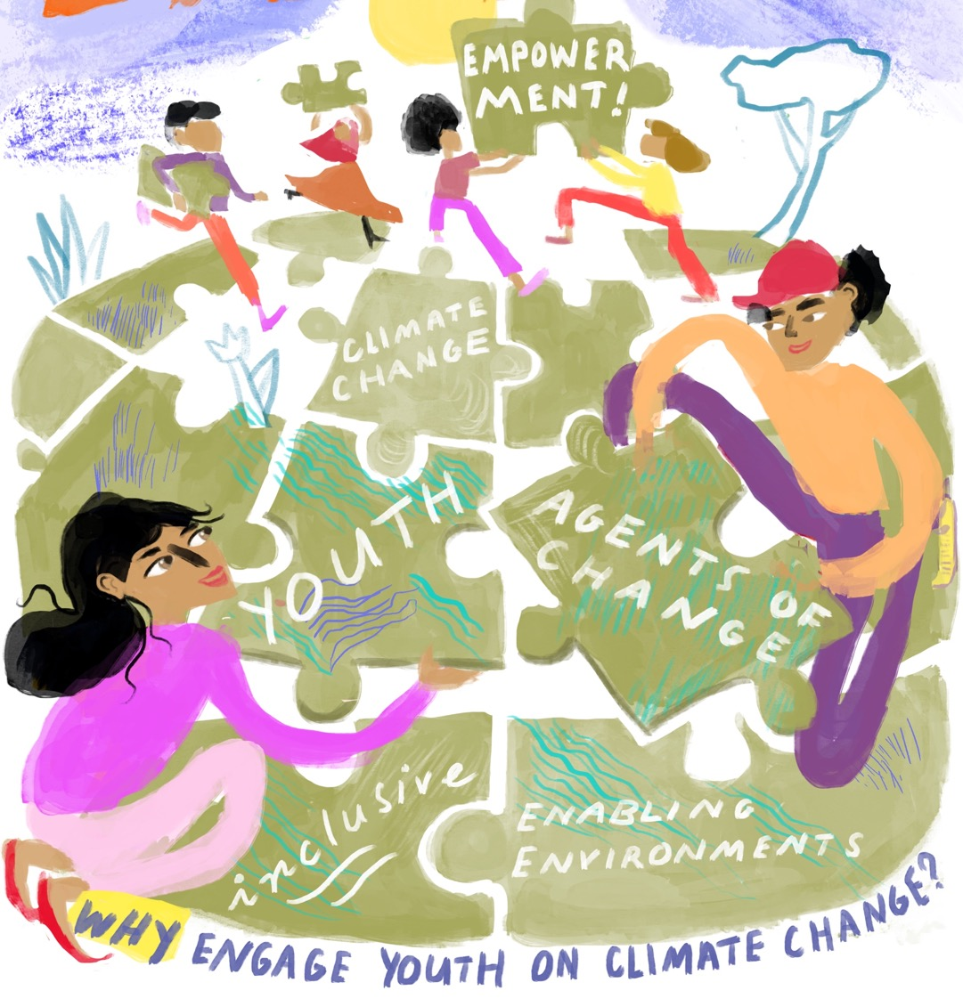

Slide 3
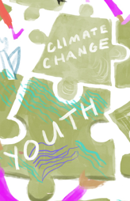
Overview
Climate change and youth
2. Youth as agents of change
3. Creating inclusive and enabling environments
4. Why engage the Red Cross Red Crescent Movement

Slide 4
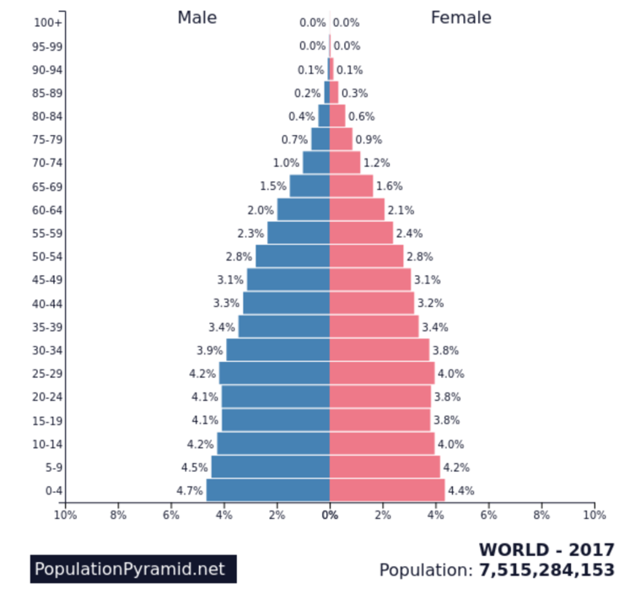
1. Climate Change and Youth
For the Red Cross Red Crescent Movement, the terms "youth" covers all people in the age range of 5 to 30 years. This includes:
Children: age 5-12
Adolescents: age 13-17
Young adults: age 18-30
In 2017, 41%
of the global population
consisted of “youth”
Notes:
In 2017, 41% of the global population consisted of “youth”, which is a considerable part of the population.
IFRC definition youth: https://media.ifrc.org/ifrc/document/youth-policy-2/
For calculation 41%, see: https://drive.google.com/drive/u/0/my-drive. Source: https://www.populationpyramid.net/world/2017/
Image youth: Youth Engagement Strategy IFRC: https://www.rcrc-resilience-southeastasia.org/document/ifrc-youth-engagement-strategy/

Slide 5
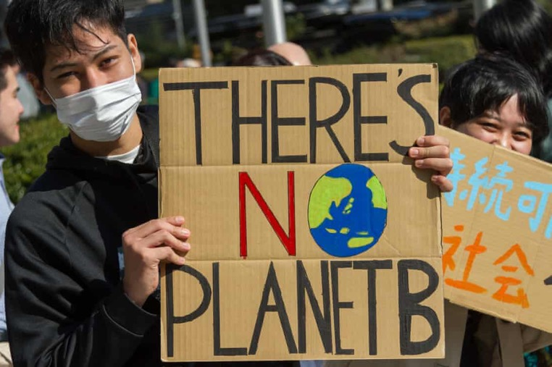
1. Climate Change and Youth Why do / should youth care?
Climate change is real and happening now!
It is already increasing the number and severity of weather related disasters
It will continue at an alarming rate unless humans drastically reduce greenhouse gas emissions
Youth will have to deal with the consequences of decisions that are made now
In 2019, an unprecedented number of youth protested to call for political action to address the climate crisis
Notes:
The IPCC is the Intergovernmental Panel on Climate Change, the leading international body for the assessment of climate change, established by the United Nations Environment Programme and the World Meteorological Organization in 1988. Thousands of scientists worldwide contribute to it and their highly detailed reports are accompanied by a “Summary for Policymakers” (SPM), approved line-by-line at formal UN meetings and endorsed by all governments. The SPM then becomes the agreed scientific basis for international negotiations about climate change and is used for national policy-making on climate by many countries.
The latest full report (2013-14) statements were clear and alarming: climate change is now unequivocal, it is bound to continue at an alarming rate unless substantial measures are taken to reduce greenhouse gas emissions and it already is and will continue to bring the world more extreme weather events.
The vast majority of scientists believe that the average global temperature rise must be limited to 2°C in order to avoid catastrophic climate change.
Many scientists consider a rise of 2 degrees C is a tipping point for disastrous and irreversible impacts, like the melting of the Arctic sea ice, Greenland ice sheet, and melting of permafrost (which would even trigger methane release, a potent greenhouse gas).
Even if greenhouse gasses are reduced substantially world wide, some scientists state we still have a 50% chance of reaching 2 degrees rise.
The IPCC is currently in its Sixth Assessment cycle, during which it will produce three Special Reports – one on 1.5ºC released 2018, one on climate change and oceans and the cryosphere expected Sept 2019, and one on climate change and land in Aug 2019 (desertification, land degradation, sustainable land management, food security, and greenhouse gas fluxes in terrestrial ecosystems), as well as a Methodology Report (guidelines for greenhouse gas inventories) in May 2019.
The 1.5˚C report highlighted:
Despite the global community’s best intentions to keep global warming below a 2°C increase above pre-industrial climate, higher levels of warming are increasingly likely.
Scientists agree that countries’ current United Nations Framework Convention on Climate Change emission pledges and commitments would most likely result in 3.5 to 4°C warming. And the longer those pledges remain unmet, the more likely a 4°C world becomes.
The full Sixth Assessment Report will be ready by April 2022 for the first UNFCCC "global stocktake" to take place in 2023; Climate Centre scientists will be among the coauthors.
Find:
the full AR5 report – and shorter summaries especially for the Red Cross Red Crescent – on www.climatecentre.org/AR5
further background on the IPCC at www.ipcc.ch or www.climatechange2013.org
Facilitator tip: consider running the 2:30 minute movie clip: “World Could Be 4 Degrees Hotter By End of This Century” available at http://www.youtube.com/watch?v=CQbOlI0YQNs
Photograph accreditations
Image: Protesters at the United Nations University in Tokyo. Photograph: Damon Coulter/Barcroft Images

Slide 6
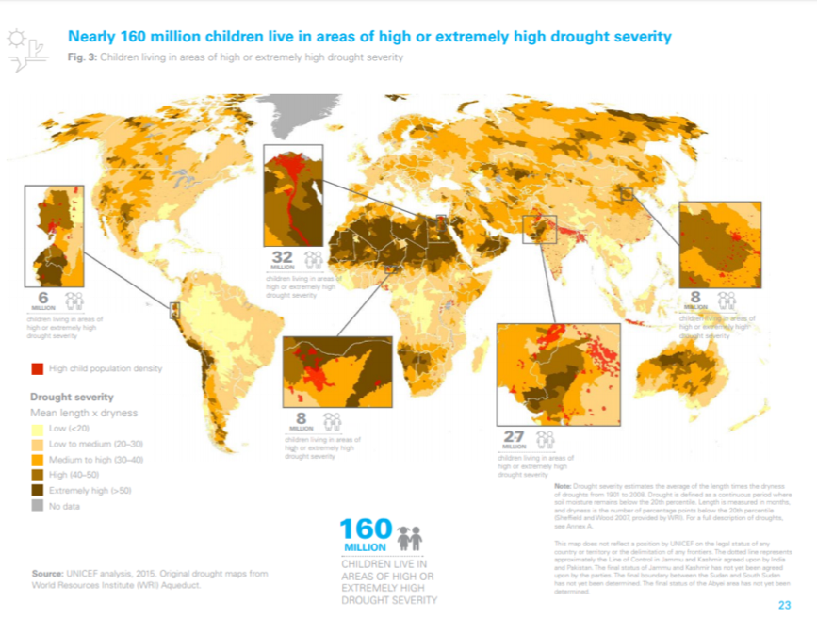
1. Climate Change and Youth Why do / should youth care?
Nearly 160 million children live in areas of high or extremely high drought severity
More than half a billion children live in extremely high flood occurrence zones

Slide 7
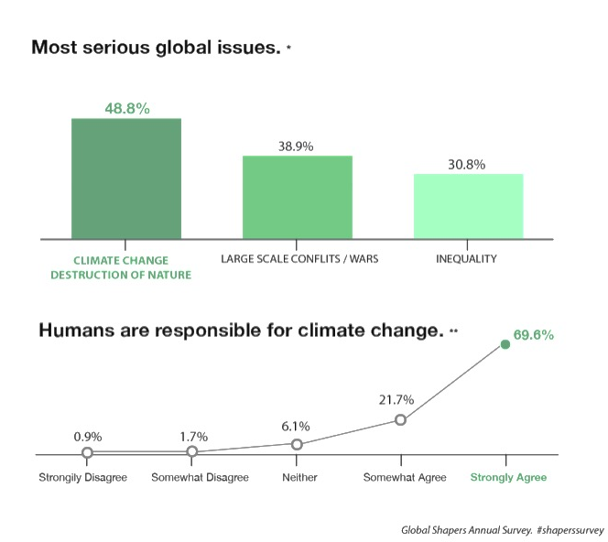
1. Climate Change and Youth What do youth think?
Young people around the world…
Think climate change and the destruction of nature is the most critical issue.
Over 90% of young people agree or strongly agree that
Humans are responsible for climate change.
Notes:
With the largest youth population in history, there is an unprecedented opportunity for young people to take an active role in shaping our future. The #ShapersSurvey was designed to highlight youth perceptions on the state of the world and action-oriented recommendations in five areas: Global Outlook, Governance, Values, Technology, and the Workplace.
Survey: 31,495 respondents from186 countries.
http://www.shaperssurvey2017.org

Slide 8
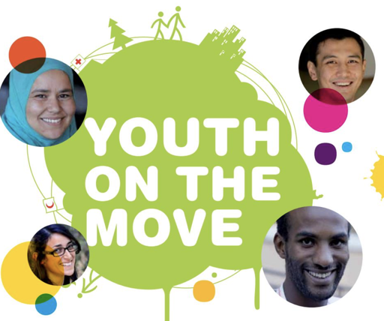
2. Youth as agents of change
The world has evolved! Youth seen as:
Victims
Agents of Change
Aware, involved & empowered youth
can be effective agents of change
in their communities to advance
climate change adaptation strategies
Notes:
Initially youth were seen as ‘victims’ needing protection
Today there is growing consensus that youth have a right to be meaningfully engaged & have their voices heard on climate change
Aware, involved & empowered youth can be effective agents of change in their communities to advance CCA strategies
Yet, many still believe that protecting, not involving, young people on climate change should be the priority
We argue protecting and enabling intersect: Evidence shows empowering young people to act through meaningful roles against harmful situations creates psychological protection through feeling more in control, hopeful and resilient

Slide 9
2. Youth as agents of change
Global map of school strikes
1.5 million school students worldwide participated in school strikes for climate action in March 2019 (WEF, March 2019)
Notes:
Un.org/youthenvoy/environment-climate-change/
Demands from the students included:
The need to declare a climate emergency and prioritise environmental reform
Teach climate change in schools
Whether related to the protests or not, by May 2019, both the UK and Ireland did declare a “climate emergency”. Ambitious targets were set to reduce greenhouse gas emissions.
There is enormous potential for youth to engage in climate action beyond mitigation (reducing greenhouse gas emissions) and focus on adaptation (addressing the consequences of a changing climate).

Slide 10
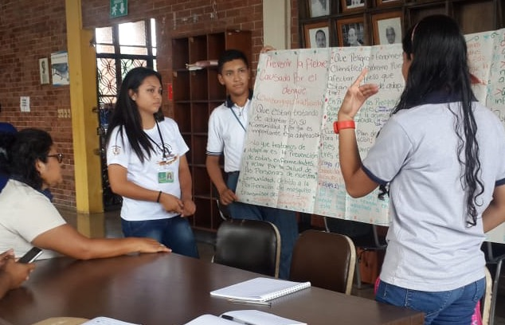
2. Youth as agents of change
By engaging youth in an inclusive, gender-sensitive manner at local, national & international levels, we invest early in:
Opening mind-sets
Fostering dialogues
Encouraging platforms to reduce cross-sectoral barriers
Inspiring youth-led action today, engages youth to advance
collaborative climate change action
going forward as tomorrows leaders
Notes:
Meaningful youth engagement can be a vehicle for transformation
Inspiring youth-led action today, engages youth to advance collaborative climate change action going forward as tomorrows leaders
Climate change is an interdisciplinary, multifaceted challenge
Encouraging collaboration across entities can be difficult
By engaging youth in an inclusive, gender-sensitive manner at local, national & international levels, we invest early in opening mindsets, dialogues & platforms to reduce cross-sectoral barriers
Photograph accreditations
Image: Guatemalan youth advocate to teachers & health clinic to run a youth-led dengue awareness campaign, due to rising temp linked to increasing the prevalence of mosquitoes (Y-Adapt) ) [Photo: Guatemala RCY]

Slide 11
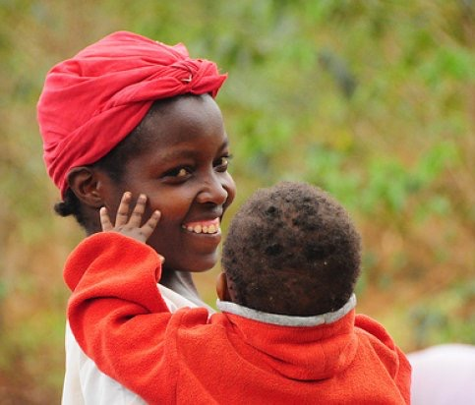
3. Creating inclusive and enabling environments – Why?
Climate change impacts can be different for boys & girls (see next slide)
Age, race, class and ability also shape how youth are impacted
During disasters, sometimes boys take on men’s roles & girls take on women’s roles
This can increase or decrease the amount boys or girls are at risk from the disaster
Gender equity and inclusivity are key in creating enabling environments for effective and sustainable youth-led influence, advocacy & action
See the ‘Gender Module’ for more information on gender & climate change
Notes:
Photograph accreditations
P Casier, CCAFs

Slide 12
3. Creating inclusive and enabling environments – Why?
Climate change impacts can be different for girls & boys⁽³⁾
GIRLS | BOYS
Girls may be especially vulnerable during disasters, as they may be caring for siblings & becoming parents themselves, with less access to healthcare | Boys are more likely to help search & rescue activities during disasters. This can have benefits but also exposes boys to additional risks
Girls may have to miss school, during disasters that effect natural resources i.e. drought, as they have to walk further to collect water or firewood | Some people expect boys to be strong and to look after themselves, which can have a negative impact on boys’ mental health
Children who don’t think of themselves as a girl or a boy, may be at greater risk from social discrimination, abuse & sufficient shelter and health options during disasters.
Notes:
Photograph accreditations
Image youth: Youth Engagement Strategy IFRC: https://www.rcrc-resilience-southeastasia.org/document/ifrc-youth-engagement-strategy/

Slide 13
3. Creating inclusive and enabling environments – How?
Place a conscious focus on inclusiveness in programs and projects. Think of: gender, age, race, class / caste / tribe, ability
Be aware of differentiated roles and responsibilities and how these may affect the vulnerability of all youth
Be aware of, and actively respond to, factors that increase the vulnerability for particular youth, such as violence and access to education
Recognise the abilities of all youth, not just their vulnerabilities

Slide 14
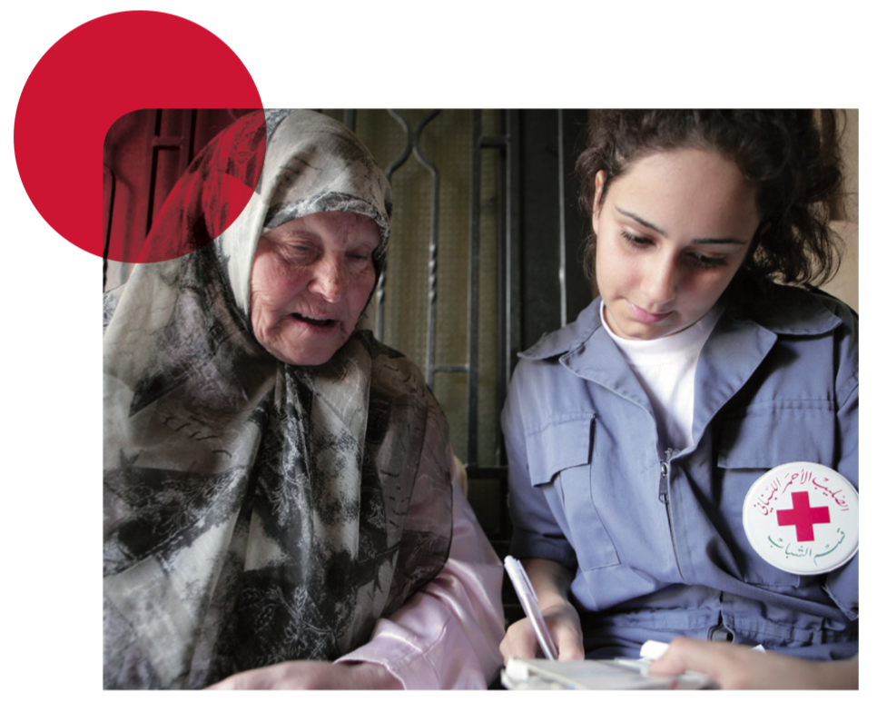
4. Why engage the Red Cross Red Crescent Movement - numbers
About half of the volunteers of the International Red Cross and Red Crescent Movement are young people, which means around 7 million youth volunteers
Notes:
Photograph accreditations
Image youth: Youth Engagement Strategy IFRC: https://www.rcrc-resilience-southeastasia.org/document/ifrc-youth-engagement-strategy/

Slide 15
4. Why engage the Red Cross Red Crescent Movement - mandate
Climate change is set to profoundly alter the way we live, and how we seek and share economic development ⁽¹⁾
Climate Change Adaptation: a priority for the Red Cross Red Crescent Movement
Previously: Climate change action referred to mitigation only: reducing greenhouse gases
Now: Climate change action includes the need to adapt to climate change impacts, as well as mitigation
Notes:
Adaptation has direct relevance to humanitarian work.
The ‘IFRC’s Framework for Climate Action Towards 2020’ prioritises addressing climate variability & change as a key component of DRR & resilience strategies.
The Climate Centre works to help the Red Cross Red Crescent Movement & partners reduce climate change impacts on vulnerable people.

Slide 16
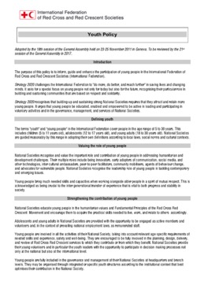
4. Why engage the Red Cross Red Crescent Movement - policies
The ‘IFRC’s Framework for Climate Action Towards 2020’
Recognises the need to better engage and mobilise regional youth networks from a knowledge and understanding perspective
Recognises the importance of youth participation in National Societies and IFRC climate-smart community programming and policy frameworks
The IFRC’s youth policy (2017)
Promotes youth as key drivers in humanitarian action & development
Youth can foster community resilience through meaningful engagement as today’s & tomorrow’s:
Leaders
Volunteers
Members of affected communities
Notes:
Other policies the Climate Centre work on youth aligns with:
IFRC Youth Engagement strategy (YES)
IFRC Climate 2020 Strategy
Partners for Resilience (PfR) strategy

Slide 17
4. Why engage the Red Cross Red Crescent Movement - opportunities
National Societies as auxiliary to government, have a strong position to cultivate youth advocacy to promote:
Meaningful participation
Youth-sensitive policies at local & national decision-making tables
There is real opportunity to effectively & innovatively advance a crucially important youth-climate change agenda across the movement
Notes:
Global network of RCRC youth offers huge potential to promote inclusive, gender sensitive, youth-led action on climate change
There is real opportunity to effectively & innovatively advance a crucially important youth-climate change agenda across the movement
The Red Cross Red Crescent Movement can strive to act as a model of good practice for wider application

Slide 18
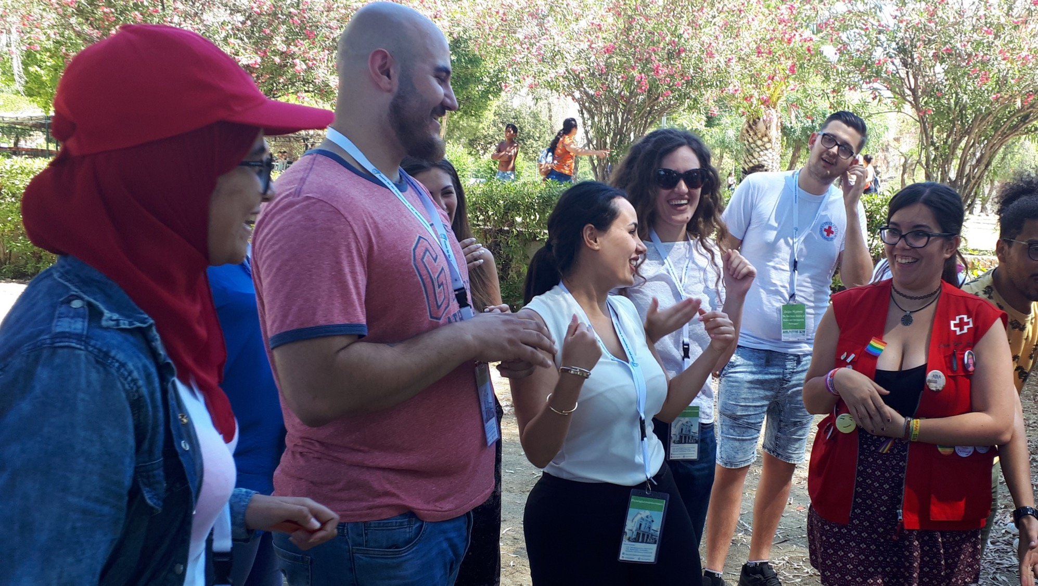
4. Why engage the Red Cross Red Crescent Movement – Climate Centre Priorities
Enabling Environments
Promote strategic integration of inclusive youth engagement and climate change agendas
Empowerment
Support inclusive youth led action and advocacy on climate change, utilizing innovative approaches
Education
Promote capacity building on climate change action and advocacy for youth and stakeholders
Notes:
For more information, see the Climate Centre youth policy: SOURCE.
Photograph accreditations Brigitte Rudram

Slide 19
Vision of success
Youth across the world are more aware, engaged & able to act to adapt and make their communities more resilient to climate variability and weather extremes from a youth sensitive, inclusive outlook
Youth & their communities are better prepared for & resilient to climate change impacts
Climate change agendas at the international, national & local level promote youth engagement, in direct alignment to & in cooperation with youth agendas & partners at all levels
Gender sensitivity & inclusivity are core to all youth engagement activities and approaches
Notes:
To learn about what you can do – see: Let’s Act!

Slide 20
References
¹ IFRC Framework for Climate Action Towards 2020
² United Nations Children’s Fund (UNICEF) (ed.) (2014) The Challenges of Climate Change: Children on the front line. UNICEF Office of Research – Innocenti
³ Shreve, C. and Fordham, M. (2018) Child-Centred Risk Reduction Research into Practice Brief: Gender and Disasters: Considering Children. Global Alliance for Disaster Risk Reduction & Resilience in the Education Sector
Graphic accreditations
Rebeka Ryvola
Photograph accreditations
Brigitte Rudram
Damon Coulter/Barcroft Images
Guatemala RCY
P Casier, CCAFs
Youth Engagement Strategy IFRC: https://www.rcrc-resilience-southeastasia.org/document/ifrc-youth-engagement-strategy/
Image accreditations
The Noun Project
Y-Adapt images

